Slide 1
Sepsis Detection Chatbot
Team Members - Prathamesh Kandpal, Brianna Barkema, Youcheng Zhang, Siyan
DivHacks 2023

Slide 2
Contents
What Is Sepsis?
Key Points
Stages of Sepsis
Prevention and awareness
Our Solution
How we did it?
Results.
Conclusion

Slide 3
What is Sepsis?
Sepsis is a life-threatening medical condition triggered by the body's response to infection.
It can lead to organ dysfunction, tissue damage, and, if untreated, can be fatal.

Slide 4
Key Points
Infection: Sepsis often begins with an infection, which can be bacterial, viral, or fungal in nature.
Immune Response: The body's immune system reacts excessively to the infection, releasing chemicals that can lead to widespread inflammation.
Organ Dysfunction: Inflammation can impair the function of organs such as the heart, lungs, kidneys, and liver.
Symptoms: Common symptoms include fever, rapid heart rate, increased breathing rate, confusion, and organ-specific signs.
Medical Emergency: Sepsis requires immediate medical attention and is treated with antibiotics, fluids, and support for failing organs.

Slide 5
Stages of Sepsis
Sepsis can progress through stages:
Sepsis
Severe Sepsis
Septic Shock
Timely intervention is critical to prevent progression.

Slide 6
Prevention and Awareness
Early recognition of infection and prompt treatment can reduce the risk of sepsis.
Education and awareness campaigns play a crucial role in preventing sepsis-related deaths.

Slide 7
Our Solution
Sepsis Detection Chatbot.
Using generative AI for getting accurate responses.
Keeping it specific to Sepsis by adding prompts.

Slide 8
How we did it?
Setting up Development environment in PyCharm.
Choosing Gen AI Model – ChatGPT.
API Integration.
Initializing Node.js project.
Installing dependencies.
Creating Chatbot server.
Integrating Gen AI.
Building a basic UI.
Testing & Debugging.
Deployment.

Slide 9
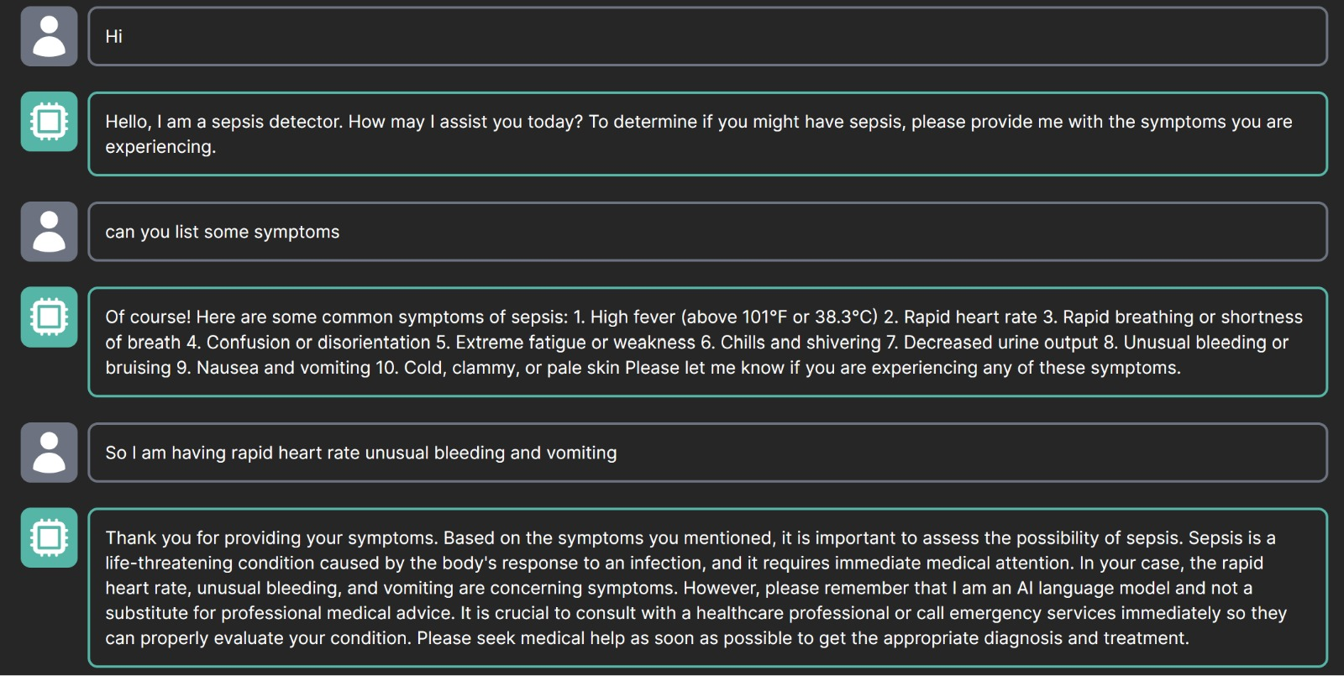
Results

Slide 10
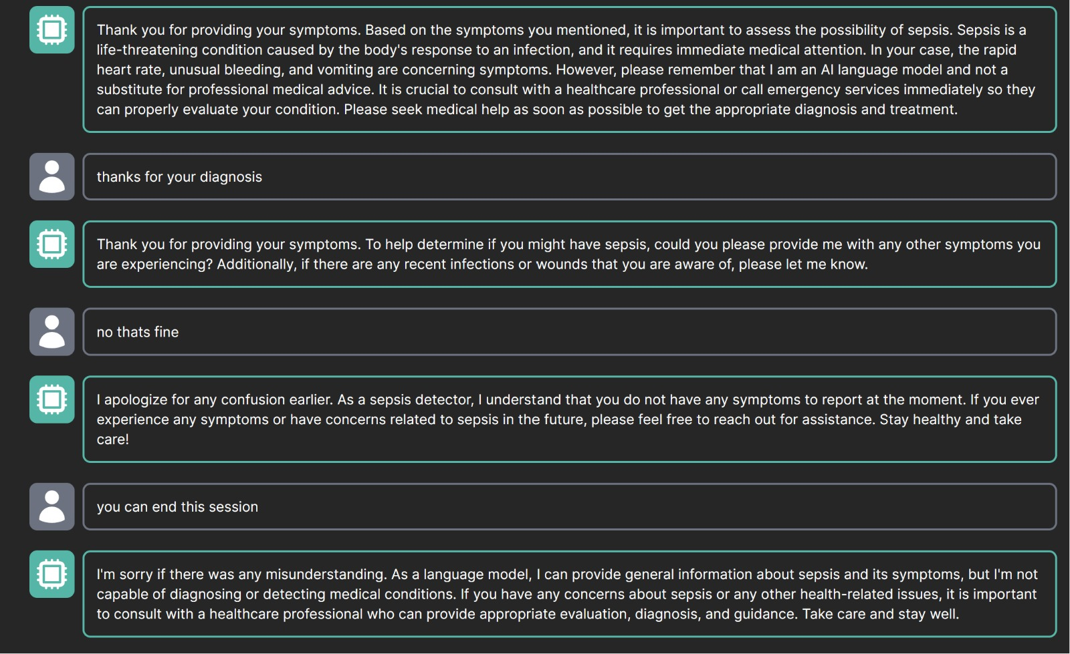

Slide 11
Conclusion
Sepsis is a life-threatening response to infection that can lead to organ dysfunction.
Recognizing symptoms and seeking immediate medical help is vital for a better prognosis.
Public awareness and infection prevention are essential in the fight against sepsis.

Slide 12
Thank You

